Slide 1
Unit 3
Problem Solving and Search techniques

Slide 2
Problem Solving
Problem solving, particularly in artificial intelligence, may be characterized as a systematic search through a range of possible actions in order to reach some predefined goal or solution.
Problem-solving methods divide into special purpose and general purpose.
A special-purpose method is tailor-made for a particular problem and often exploits very specific features of the situation in which the problem is embedded.
In contrast, a general- purpose method is applicable to a wide variety of problems.
One general-purpose technique used in AI is means-end analysis—a step-by-step, or incremental, reduction of the difference between the current state and the final goal.

Slide 3
Four general steps in problem solving:
1. Goal formulation
What are the successful world states
2. Problem formulation
What actions and states to consider given the goal
3. Search
Determine the possible sequence of actions that lead to the states of known values
and then choosing the best sequence.
4. Execute
Give the solution perform the actions.

Slide 4
Problem formulation:
A problem is defined by:
An initial state: State from which agent start
Successor function: Description of possible actions available to the agent.
Goal test: Determine whether the given state is goal state or not
Path cost: Sum of cost of each path from initial state to the given state.
A solution is a sequence of actions from initial to goal state. Optimal solution has the lowest path
cost.

Slide 5
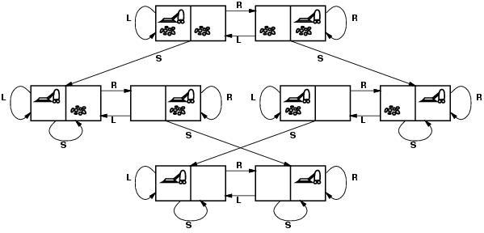
State Space representation
The state space is commonly defined as a directed graph in which each node is a state and each arc represents the application of an operator transforming a state to a successor state.
A solution is a path from the initial state to a goal state.

Slide 6
States?? two locations with or without dirt: Initial state?? Any state can be initial
Actions?? {Left, Right, Suck}
Goal test?? Check whether squares are clean. Path cost?? Number of actions to reach goal.

Slide 7
Production System:
A production system (or production rule system) is a computer program typically used to provide some form of artificial intelligence, which consists primarily of a set of rules about behavior.
These rules, termed productions, are a basic representation found useful in automated planning, expert systems and action selection.
A production system provides the mechanism necessary to execute productions in order to achieve some goal for the system.
Productions consist of two parts: a sensory precondition (or "IF" statement) and an action (or "THEN"). If a production's precondition matches the current state of the world, then the production is said to be triggered.

Slide 8
If a production's action is executed, it is said to have fired. A production system also contains a database, sometimes called working memory, which maintains data about current state or knowledge, and a rule interpreter.
The rule interpreter must provide a mechanism for prioritizing productions when more than one is triggered.
The underlying idea of production systems is to represent knowledge in the form of condition-action pairs called production rules:
If the condition C is satisfied then the action A is appropriate. If it is raining then open the umbrella.

